Slide 1


IPL Data Analysis
With Power BI
Presented by:- Kajol Gupta

Slide 2


Introduction
Ten teams battle it out in Twenty20 matches across India. This analysis delves into the Indian Premier League (IPL), focusing on key performance metrics of teams and players. By leveraging Power BI, the project explores batting and bowling performances, match outcomes, and team statistics across multiple seasons.

Slide 3










Team Playing
Chennai Super Kings
Gujarat Titans
Delhi Capitals
Kolkata Knight Riders
Lucknow Super Giants
Punjab Kings
Mumbai Indians
Rajasthan Royals
Sunrisers Hyderabad
Royal Challengers Bengaluru

Slide 4
Goals
The goal of this Power BI project is to analyze IPL (Indian Premier League) cricket data to gain insights into team and player performance, match outcomes, and various key metrics related to both batting and bowling. The analysis will be carried out using data from multiple related tables, providing a comprehensive view of the tournament's dynamics.

Slide 5
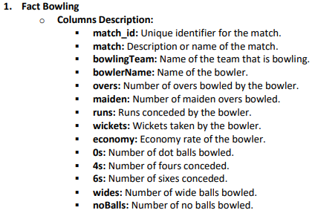
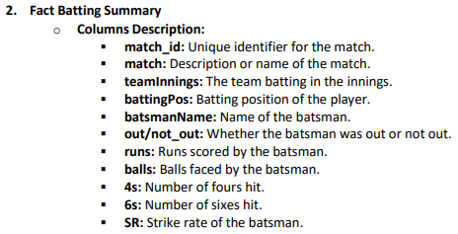
Datasets

Slide 6
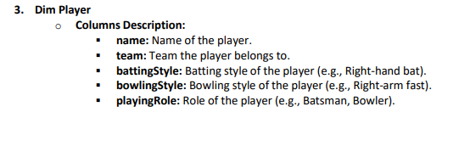
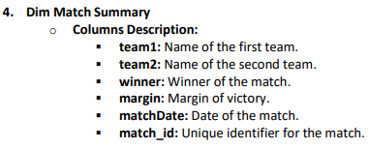
Datasets

Slide 7
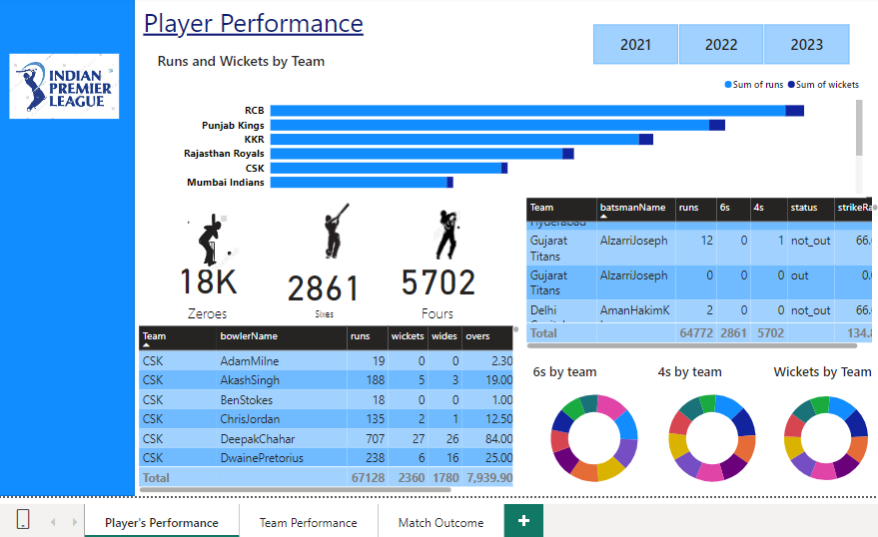
Player Performance

Slide 8
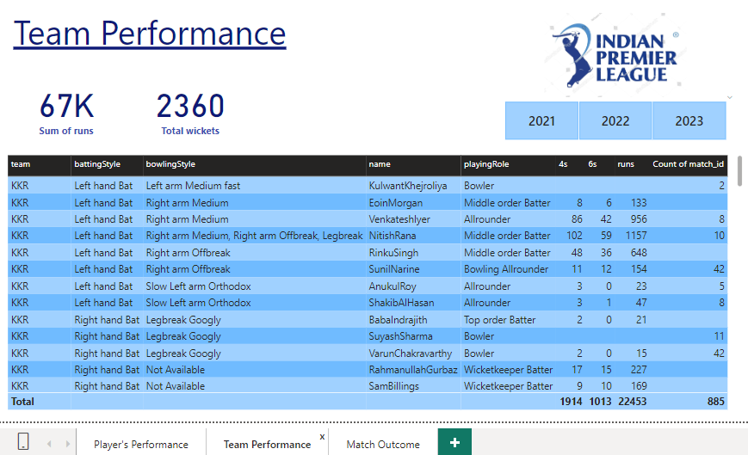
Team Performance

Slide 9
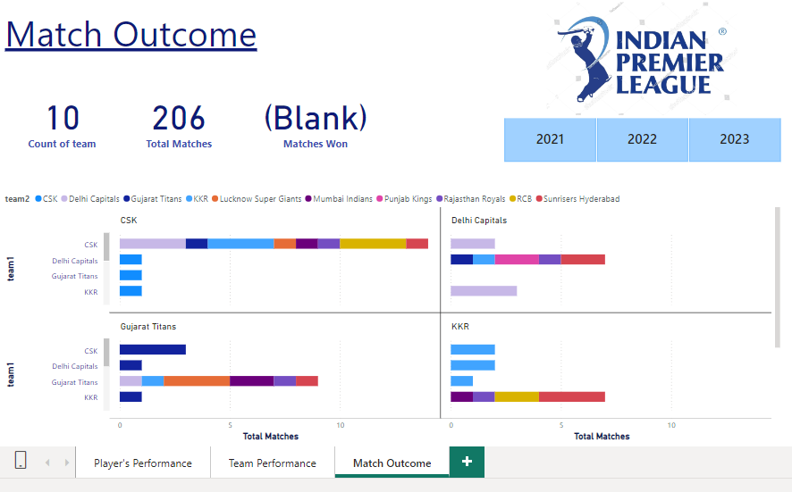
Match Outcome

Slide 10
Player Performance Insights
Runs and Wickets Contribution: The analysis reveals the key players contributing to runs and wickets for their respective teams. It highlights top performers in both batting and bowling categories.
Boundary Contribution: The donut charts provide insights into how sixes and fours contribute to the team's overall score. This helps in understanding the aggressiveness of the batting strategy.
Overall Team Performance: The team-wise breakdown of runs, wickets, and extras (zeros) indicates the balance between different teams' strengths in batting and bowling.

Slide 11
Team Performance Insights
Batting and Bowling Styles: The table shows the diversity in batting and bowling styles within each team, reflecting the strategic choices made by teams in building their squad.
Run and Wicket Totals: The summary of total runs scored and wickets taken provides a quick overview of team efficiency. Teams like KKR and CSK stand out in terms of their cumulative performance.
Player Role Distribution: The roles played by various team members (e.g., all-rounders, bowlers, middle-order batters) show how teams have utilized their players in different positions to maximize performance.

Slide 12
Match Outcome Insights
Team Performance: The visual shows a distribution of matches won by different teams across the IPL seasons (2021-2023). It provides a clear comparison of team performance in terms of match wins and losses.
Team Comparison: Teams like CSK and Gujarat Titans have consistently performed well, securing the highest number of wins across seasons, while some other teams have a more mixed performance.
Total Matches and Teams: The total number of matches played and the total number of teams are clearly presented, showing the scale of the competition.

Slide 13

Conclusion
This analysis underscores the importance of strategic planning and player utilization in achieving success in the IPL. By leveraging such data-driven insights, teams can refine their strategies and improve performance in future seasons.

Slide 14
Thank You!
.

